Slide 1

Influence of Charaka Samhita and Sushruta Samhita on Modern Medical Practices
The ancient Indian medical treatises, Charaka Samhita and Sushruta Samhita, have exerted a profound influence on the development of modern medical practices. These foundational texts of Ayurveda, the traditional Indian system of holistic healthcare, laid the groundwork for comprehensive approaches to diagnosis, treatment, and disease prevention that continue to inform integrative and complementary medicine worldwide.

Slide 2
Index :
Introduction to Ayurveda and the Classical Indian Medical Texts
1
2
Charaka Samhita: Principles of Holistic Healthcare
3
Sushruta Samhita: Groundbreaking Advancements in Surgery
4
Diagnostic Methods in Ayurveda: Pulse, Tongue, and Facial Analysis
5
Concepts of Dosha, Dhatu, and Mala in Ayurvedic Medicine
Principles of Lifestyle and Diet in Ayurvedic Healing
6
Herbal Remedies and Medicinal Compounds from Ayurveda
7
Influence of Ayurvedic Practices on Modern Integrative Medicine
8
Conclusion: The Enduring Legacy of Charaka and Sushruta
9

Slide 3

Introduction to Ayurveda and the Classical Indian Medical Texts
1
Ayurveda: The Science of Life
2
The Foundational Texts
3
A Comprehensive Approach
Ayurveda is a holistic system of medicine that originated in ancient India, emphasizing the balance of body, mind, and spirit for optimal health and wellbeing.
Charaka Samhita and Sushruta Samhita are the two most renowned classical Indian medical texts, dating back to the 1st millennium BCE and CE, respectively.
These texts cover a vast range of topics, from diagnosis and treatment to preventative care, nutrition, and lifestyle recommendations.

Slide 4
Charaka Samhita: Principles of Holistic Healthcare
Comprehensive Diagnosis
Individualized Treatment
Preventative Care
Charaka Samhita stresses the importance of a thorough patient evaluation, considering physical, mental, and spiritual factors to understand the root of their health issues.
The text promotes customized treatment plans, tailored to each individual's unique constitution and needs, rather than a generic approach.
Charaka Samhita emphasizes maintaining health through proper diet, lifestyle, and stress management, going beyond simply treating symptoms.

Slide 5
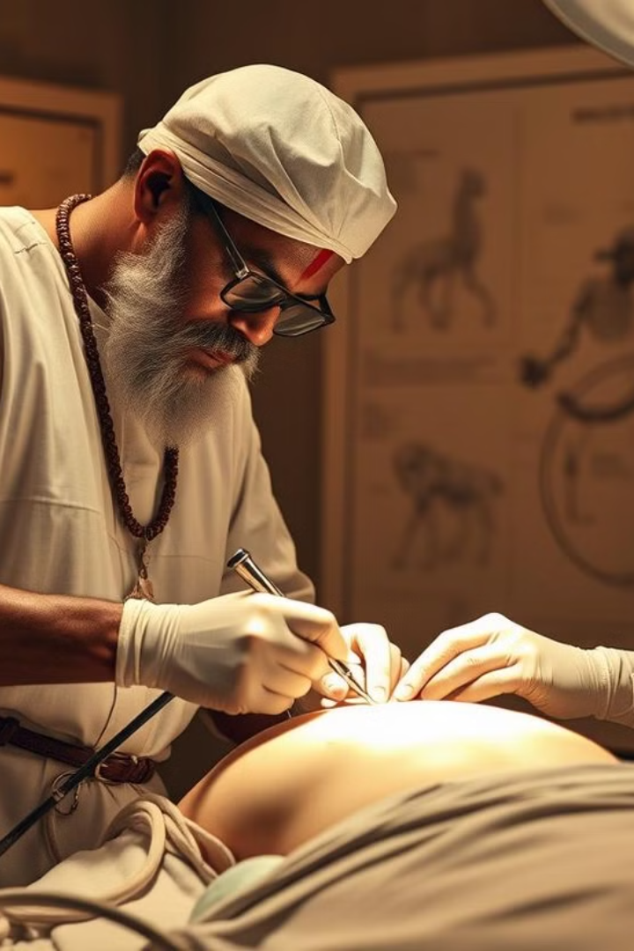
Sushruta Samhita: Groundbreaking Advancements in Surgery
Innovative Instruments
Comprehensive Anatomy
Sushruta Samhita outlines the design and use of a variety of specialized surgical instruments, many of which are still recognized as essential tools in modern medical practice.
Sushruta Samhita provides detailed descriptions of human anatomy, including the identification and classification of over 300 bones, muscles, and other structures.
1
2
3
Advanced Surgical Techniques
The text describes over 120 surgical procedures, including rhinoplasty, cataract surgery, and the removal of foreign objects, demonstrating a sophisticated understanding of the human body.

Slide 6
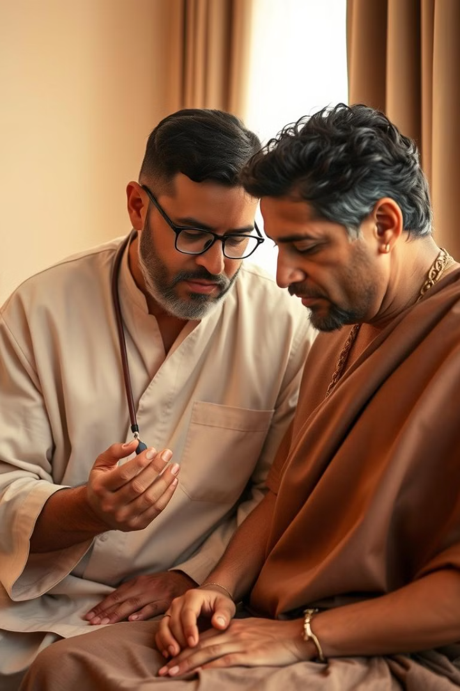
Diagnostic Methods in Ayurveda: Pulse, Tongue, and Facial Analysis
Pulse Diagnosis
Tongue Analysis
Ayurvedic practitioners use a sophisticated pulse examination technique to assess the balance of the body's three main energetic forces (doshas), providing crucial diagnostic information.
The appearance and characteristics of the tongue are closely observed in Ayurveda, as they are believed to reflect the overall state of health and imbalances within the body.
Facial Features
Ayurvedic diagnostics also involve a detailed examination of the face, as facial features are thought to provide insights into an individual's constitution and potential health concerns.

Slide 7



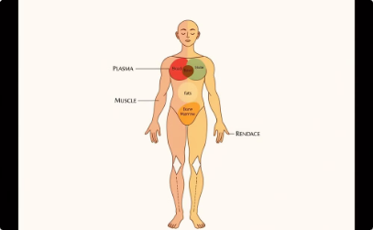
Concepts of Dosha, Dhatu, and Mala in Ayurvedic Medicine
Vata
Pitta
Kapha
Dhatu
The principle of movement and energy responsible for bodily functions like circulation, respiration, and nerve impulses. Vata governs how we think, feel, and move, and imbalances can manifest as anxiety, insomnia, and digestive issues.
The principle of transformation and metabolism, governing processes like digestion, absorption, and hormone regulation. Pitta is linked to our digestive fire, and imbalances can lead to inflammation, skin problems, and anger.
The principle of structure and lubrication, responsible for maintaining body tissues, immunity, and physical strength. Kapha provides stability and grounding, and imbalances can manifest as weight gain, congestion, and lethargy.
The seven essential bodily tissues that provide structure, nourishment, and support for the body's functions. These include rasa (plasma), rakta (blood), mamsa (muscle), meda (fat), asthi (bone), majja (bone marrow), and shukra (reproductive tissue). Each dhatu is interconnected and relies on the proper functioning of the doshas for optimal health.

Slide 8

Principles of Lifestyle and Diet in Ayurvedic Healing
Circadian Rhythms
1
Ayurveda emphasizes the importance of aligning one's daily routine with the natural rhythms of the body and environment to promote balance and wellbeing.
2
Seasonal Considerations
Ayurvedic practices recommend adjusting diet and lifestyle based on the changing seasons to maintain harmony with the rhythms of nature.
Personalized Nutrition
3
Ayurvedic dietary recommendations are tailored to an individual's unique constitution (dosha) and health needs, rather than a one-size-fits-all approach.

Slide 9
Herbal Remedies and Medicinal Compounds from Ayurveda
Medicinal Plants
Ayurvedic Formulations
Cutting-Edge Research
The Charaka and Sushruta Samhitas describe the therapeutic properties and applications of hundreds of medicinal plants, many of which are still used in modern phytotherapy.
These texts also outline the preparation of complex herbal compounds and mixtures, leveraging synergistic interactions between various plant-based ingredients.
Ongoing scientific research is validating the efficacy of many Ayurvedic herbal remedies and providing insights into their active compounds and mechanisms of action.

Slide 10




Influence of Ayurvedic Practices on Modern Integrative Medicine
Holistic Approach
Ayurvedic principles of addressing the root causes of disease through a balanced integration of physical, mental, and spiritual well-being have influenced the rise of integrative and complementary medicine worldwide.
Herbal Medicine
The wealth of knowledge on medicinal plants and compound formulations from Ayurvedic texts has led to increased scientific research and integration of plant-based therapies into modern healthcare.
Personalized Treatment
The Ayurvedic emphasis on individualized diagnosis and treatment plans has inspired healthcare providers to adopt more personalized, patient-centered approaches to care.

Slide 11

Conclusion: The Enduring Legacy of Charaka and Sushruta
The Charaka Samhita and Sushruta Samhita, two of the oldest and most comprehensive medical texts in the world, have left an indelible mark on the evolution of healthcare practices globally. Their holistic approach to wellness, emphasis on personalized treatment, and groundbreaking advancements in surgical techniques continue to inspire and inform modern integrative and complementary medicine. As scientific research further validates the wisdom of these ancient Indian texts, their influence is expected to grow, enriching and expanding the frontiers of healthcare for generations to come.

Slide 12

Thank you!
This presentation was presented by Group - 2 - AIML(C).

